Slide 1
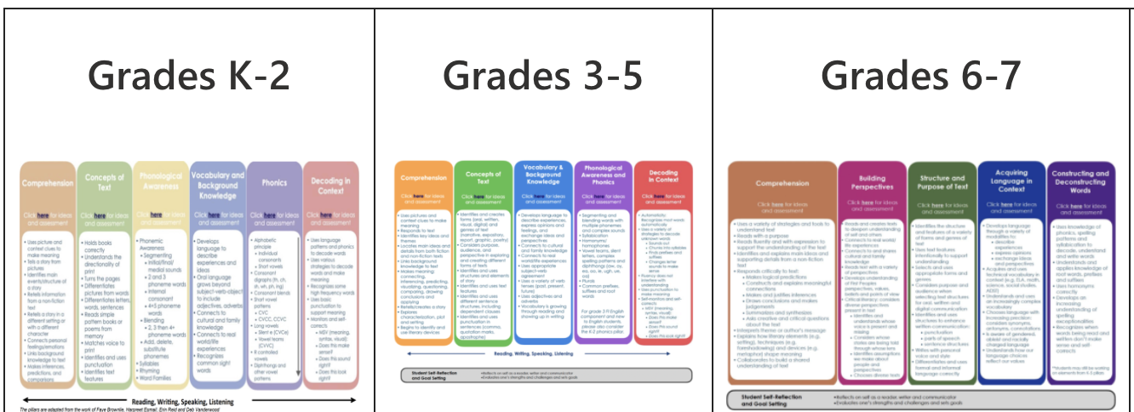
Pillars of Literacy

